Slide 1






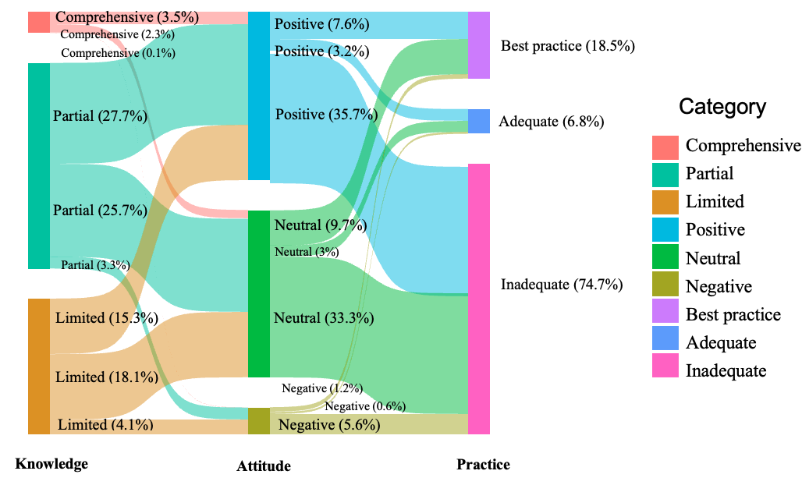
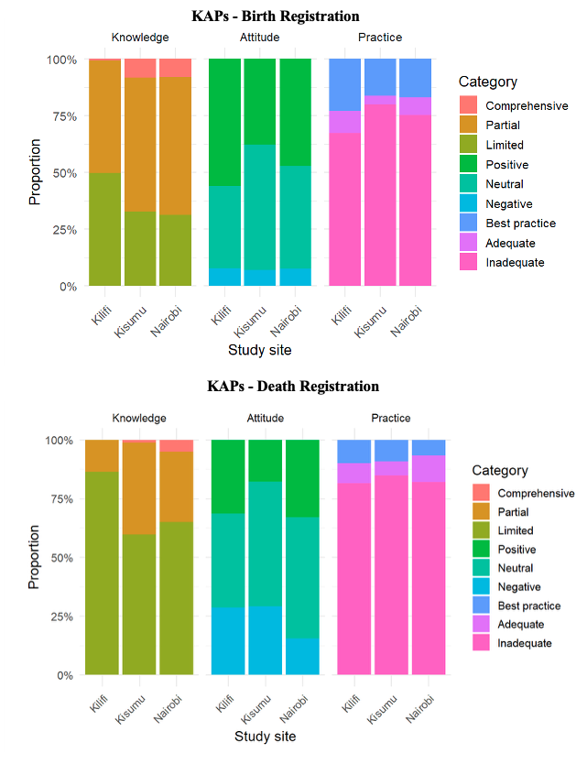
Improving CRVS for Universal Health Coverage: Assessing the Knowledge-Practice Gap in Birth and Death Registration in Kenya
Rajwayi M¹, Osoro CB1, Bukosia J¹, Sifuna P², Omolo K², Nyaguara A¹, Were V³, Waluke I¹, Mwanzia B¹, Onyango SA¹, Odipo E¹, Nyundo C¹, Helleringer S⁴, Snow RW^{1,5}, Okiro EA^{1,5}
¹Kenya Medical Research Institute-Wellcome Trust Research Programme, Nairobi, Kenya, ²Kenya Medical Research Institute–Walter Reed Army Institute of Research, Kisumu, Kenya, ³African Population Health Research Centre, Nairobi, Kenya, ⁴New York University, Abu Dhabi, UAE, ⁵Centre for Tropical Medicine and Global Health, Nuffield Department of Medicine, University of Oxford, Oxford, UK
BACKGROUND
RESULTS AND DISCUSSION
Civil Registration of Vital Statistics: continuous, permanent, compulsory recording of vital events, e.g. births and deaths.
Why: Provides legal identity, protects child rights, provides access to education and supports governments’ health and policy planning.
Kenya ( KVSR 2023–24): births registration fell 77.1%→70.3%; deaths registration 45.1%→44.8%.
Objective: Assess KAP factors influencing birth & death registration across three HDSS sites (Kilifi, Nairobi, Kisumu).
High partial/limited knowledge levels exist, but registration practice remains inadequate.
Attitudes levels were mixed.
For births, high knowledge with positive attitude was significantly associated with registration practice.
For deaths, knowledge was significantly associated with registration practice.
METHODOLOGY
Sankey diagram of Knowledge–Attitude–Practice (KAP) levels for Birth Registration (N = 1,611).
Cross-sectional household survey, July–December 2024.
Simple random sampling: 1,616 birth households; 1,387 death households (births 2020–2023; deaths 2022–2023).
KAPs: Knowledge (notification, procedures, benefits); Attitudes (perceived benefits, bias); Practices (registration, certification).
Analysis: Chi-square, Cochran-Mantel-Haenszel (cMH), logistic regression (knowledge*attitude, interaction).
Geographic Distribution of Sampled Households for Birth and Death Registration KAP Surveys Across the Three HDSS Sites.
Logistic Regression Models Estimating the Association Between Knowledge, Attitudes, and Registration Practices for Births And Deaths
BIRTH REGISTRATION
Characteristic | Unweighted : OR (95% CI) |  | Weighted : OR (95% CI)
 | ¹Model 1 | ²Model 2 | ¹Model 1 | ²Model 2
Intercept | 0.17 (0.11–0.26)* | 0.18 (0.11–0.27)* | 0.15 (0.09–0.28)* | 0.19 (0.10–0.35)*
Knowledge: High (ref = Low) | 1.77 (1.36–2.32)* | 1.71 (1.22–2.41)* | 1.50 (0.98–2.29) | 1.04 (0.59–1.85)
Attitude: Positive (ref = Negative) | 0.76 (0.60–0.97)* | 0.71 (0.45–1.11) | 1.13 (0.75–1.69) | 0.59 (0.30–1.17)
High Knowledge × Positive Attitude | _ | 1.10 (0.65–1.90) | _ | 2.50 (1.05–5.97)*
DEATH REGISTRATION
Intercept | 0.14 (0.07–0.27)* | 0.15 (0.08–0.29)* | 0.04 (0.01–0.13)* | 0.05 (0.01–0.14)*
Knowledge: High (ref = Low) | 3.03 (2.20–4.19)* | 2.67 (1.86–3.83)* | 4.96 (2.68–9.19)* | 4.01 (1.96–8.21)*
Attitude: Positive (ref = Negative) | 0.57 (0.38–0.82)* | 0.40 (0.20–0.72)* | 1.02 (0.51–2.03) | 0.47 (0.19–1.13)
High Knowledge × Positive Attitude | _ | 1.85 (0.84–4.27) | _ | 2.99 (0.80–11.20)
CONCLUSION AND RECOMMENDATIONS
Combining knowledge improvement and perception change could improve birth registration uptake i.e. emphasis on benefits of registration.
Targeted context-specific interventions are essential to achieve equitable and sustainable improvements i.e. involvement of community health practitioners, digitalized systems like Unique Personal Identifiers( UPIs) and decentralizing CRS offices to increase national coverage.
Contact: rajwayi.mike@gmail.com

